Slide 1
Team V1V1 Main_Presentation
Image generation Challenge
김다현(Kim Dahyun),
박준우(Park Junwoo), 김건호(Kim Geonho)

Slide 2
Contribution
Park Junwoo: FQ-GAN, Data Augmentation, Github
Kim Geonho : EDM, Beta_d, Learning Rate scheduler, SuperClass
Kim Dahyun: DDPM, Metric Code, Dropout
Park Junwoo : 33%
Kim Geonho : 33%
Kim Dahyun : 33%

Slide 3
01
FQ-GAN

Slide 4
FQ-GAN - Problems of GAN
Unstable Training:
GAN training heavily depends on the statistics of mini-batches.
If the batch samples do not adequately represent the overall data distribution, the training process becomes unstable.
As a result, feature matching between real and fake data may not be achieved effectively.
Excessive Expressiveness of the Discriminator:
In continuous feature spaces, the Discriminator learns extremely complex features to distinguish between real and fake data.
The Generator needs to adapt to the features learned by the Discriminator.
However, when the Discriminator learns overly intricate and complex features, the Generator struggles to meet these sophisticated criteria, leading to difficulties in training.

Slide 5
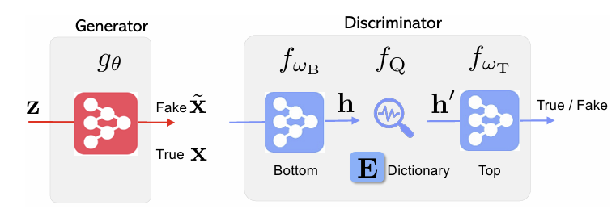
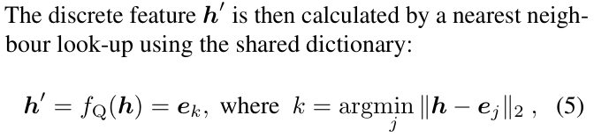
FQ-GAN
Feature Quantization:
FQ-GAN converts continuous features ℎ into discrete features ℎ' based on a dictionary.
Dictionary Look-up: Data is mapped to the nearest centroid.
The dictionary is composed of 𝐾 centroids 𝑒_𝑘.
Quantization is performed by finding the nearest 𝑒_𝑘 to ℎ.
The centroids are dynamically updated during training, based on the distribution of input data and the extracted feature vectors.

Slide 6
FQ-GAN
Consistent and Stable Training Possible
In continuous feature spaces, real and fake data can differ by very subtle details.
In quantized, feature vectors are restricted to centroids.
This increases the likelihood of feature matching and makes training easier.
Discriminator's expressiveness is constrained, making it easier for the Generator to adapt and follow.
Reduced Dependence on Mini-Batch Statistics
Instead of relying on continuous features, quantization maps features to predefined centroids.
Quantized features depend more on centroids, which better represent the overall data distribution than the specific characteristics of individual mini-batches.
Even if individual mini-batches vary in their specific data characteristics, quantization normalizes these differences in a consistent way.

Slide 7
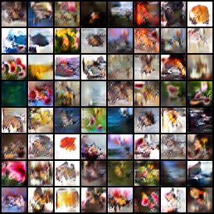
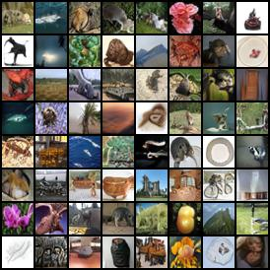
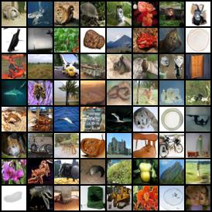
FQ-GAN
500 Epochs Training Time : about 15 hours
FID : 7.2699
Intra-FID: 35
Inception Score: 9.167 +/- 0.120

Slide 8
02
DDPM

Slide 9

DDPM
Forward Process (Noise Addition):
The Forward Diffusion Process describes the transformation of data into noise, ultimately reaching Gaussian noise. It operates in reverse to sampling and is based on a Markov Chain.
x0​: Initial data.
x_t​: Data at step t with added noise.
β_t​: Variance schedule at step t.
Variance Schedule:
The noise level β_t​ gradually increases, starting small and growing larger, to transform data into Gaussian noise. It is scaled by 1−β_t​ to preserve variance during this process.

Slide 10

DDPM
Reverse Process (Data restoration):
The Reverse Diffusion Process restores data by removing noise added during the Forward Process.
μ_θ​: Predicted mean by the trained model.
Σθ​: Predicted variance by the trained model.
Gaussian Transition:
The Reverse Process models using a Gaussian Transition in a Markov Chain. It learns μ_θ​ and Σθ​ from Forward Process data.

Slide 11

DDPM
Loss Function
The goal is to optimize θ, the Reverse Process parameters, to maximize the true data distribution p_θ(x_0). This is achieved by minimizing the Negative Log-Likelihood (NLL).
KL Divergence: Minimizes distribution differences between Forward Process (q) and Reverse Process (p_θ​).

Slide 12
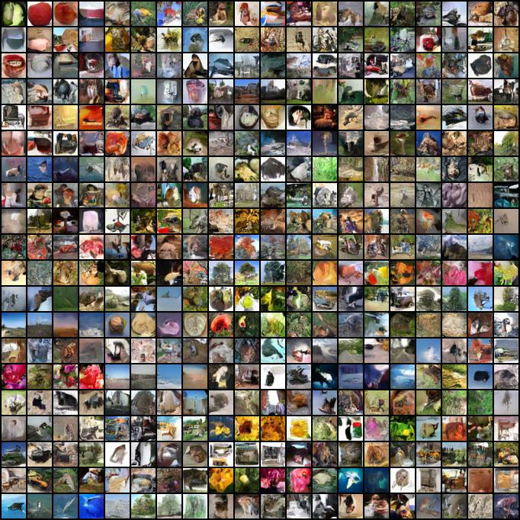
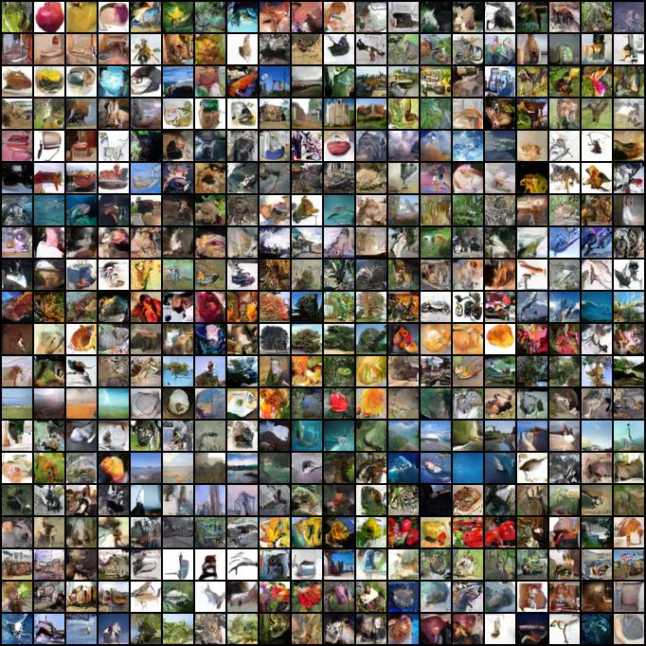
DDPM
Previous
epoch: 50 epochs
timesteps: 500 timesteps
updated
epoch: 150 epochs
timesteps: 1000 timesteps

Slide 13
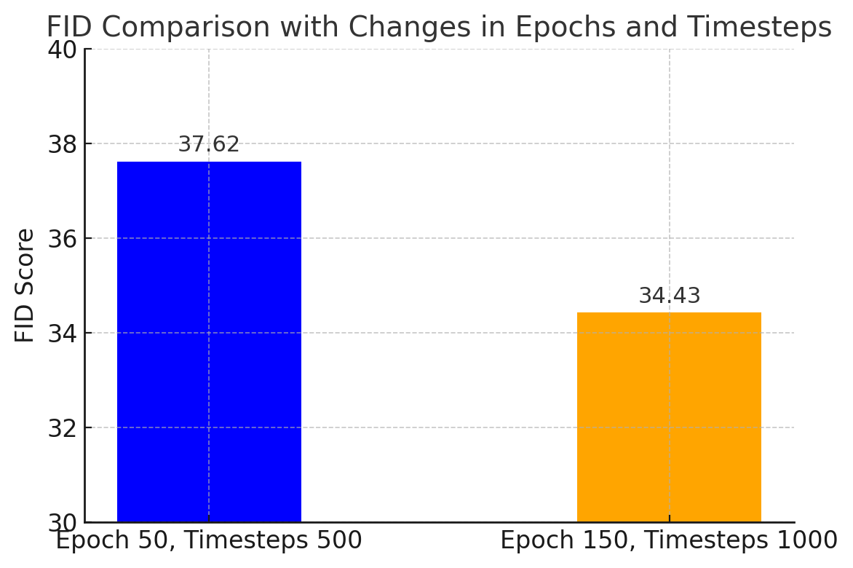
DDPM
Increased Epochs and Timesteps (Epochs: 50 → 150, Timesteps: 500 → 1000)Extending the training period and applying finer timesteps allowed the model to better learn the data distribution and achieve more precise noise removal
As a result, image quality improved, and the FID score decreased from 37.62 → 34.43

Slide 14
03
EDM(DDPM++)

Slide 15

EDM(DDPM++)
Forward Process (Noise Addition):
1. Input Data Transformation
Data x and noise scale σ are converted to 32-bit floating-point precision. σ is reshaped into a 4D tensor (batch size, channels, height, width).

Slide 16

EDM(DDPM++)
Forward Process (Noise Addition):
2. Scaling Coefficients Calculation
C_skip​: Maintains the input x.
C_out: Scales the model output F(x).
C_in​: Maps input x to noise space.
C_in: This adjusts the input x into the noise space, which is then used as the input for the model F(x).
C_out: This coefficient is used to transform the model's output into the data space.

Slide 17
EDM(DDPM++)
Forward Process (Noise Addition):
3. Noise Level Calculation
C_noise​: Represents the relative noise level, providing additional information to the model based on σ and β

Slide 18
EDM(DDPM++)
Forward Process (Noise Addition):
4. Model Input Generation
C_in​⋅x: Maps input data to noise space.
C_noise​: Conveys noise level information to the model.
F(x): Outputs the predicted "score function" or correlation between data and noise.

Slide 19


EDM(DDPM++)
Reverse Process (Noise Addition):
5. Final Output Calculation
X: Data with added noise in the Forward process.
σ : Represents the intensity of the added noise during the Forward process.
F: Trained network (denoising function). This network removes noise and performs predictions on the original data.
x/{sqrt{σ2+1​}} ​: Normalized current state x, adjusted according to the noise level.
C_noise​:Conditional information representing the time step t. The network F receives the current noise level.
Thus, the Forward process involves adding noise to the initial data, enabling the model to learn the data distribution. The Reverse process uses the trained model to remove noise and restore the original data.

Slide 20


EDM(DDPM++)
Sampling
1. Time Step Calculation
Time steps t_i​ define noise level changes, calculated using ρ-scaling in the EDM method.
σ_min​: Minimum noise level.
σ_max​: Maximum noise level.
ρ: Parameter for nonlinear scaling adjustment.
N: Number of time steps.

Slide 21

EDM(DDPM++)
Sampling
2. Initial State Setup
The initial latent vector x_T​ starts as Gaussian noise at the highest noise level σ_max
Latents are latent vectors sampled from a standard Gaussian distribution.
Multiplying by σ_max reflects the initial noise level.

Slide 22
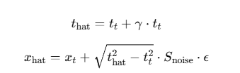

EDM(DDPM++)
Sampling
3. Reverse Diffusion Loop (Time Step Iteration)
(a) Noise Increase
γ: Noise increase ratio.
ϵ∼N(0,I) : Gaussian sample.

Slide 23
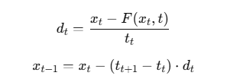

EDM(DDPM++)
Sampling
3. Reverse Diffusion Loop (Time Step Iteration)
(b) Euler Update (First-Order Accuracy)
Updates x_t using the Euler method, predicting noise in the first step.
net(x_hat, t_hat, class_labels) predicts the noise.
d_cur represents the change at the current time step.

Slide 24
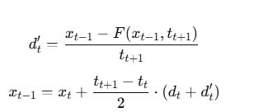
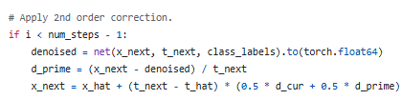
EDM(DDPM++)
Sampling
3. Reverse Diffusion Loop (Time Step Iteration)
(c) Heun Correction (Second-Order Accuracy):
Calculates d_t​ again for correction, improving accuracy.
d_prime represents the recalculated change at x_{t-1}​.
Improves accuracy by calculating the corrected x_{t-1}.

Slide 25

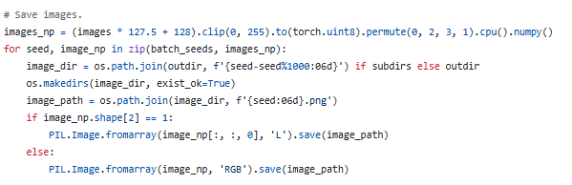
EDM(DDPM++)
Sampling
4. Final Output
x0​ is restored as the final generated image, normalized and saved.

Slide 26
03
Vploss

Slide 27

VPLOSS
Variance Preserving (VP) Loss is a loss function defined based on the Variance Preserving (VP) formulation in EDM. This loss function is used to train the denoising process by comparing the images and the network outputs.
1. Random Noise Level Sampling
t: Uniformly sampled value in the range [1,ϵt].
β_d​,β_min​: Hyperparameters for VP loss.
ϵ_t​: Minimum t value (smaller implies lower noise levels).
β_d​: Adjusts the rate of noise increase.
β_min: Minimum noise level.
ϵ_t: Minimum value of t.

Slide 28

VPLOSS
Variance Preserving (VP) Loss is a loss function defined in EDM based on the Variance Preserving (VP) formulation. This loss function compares the images with the network's outputs and is used to learn the noise removal process
2. Adding Noise
ϵ: Gaussian noise.
n: Noise scaled by σ.
torch.randn_like(y) generates Gaussian noise of the same size as the image. This is scaled by σ to create the noise nnn.

Slide 29

VPLOSS
Variance Preserving (VP) Loss is a loss function defined based on the Variance Preserving (VP) formulation in EDM. This loss function is used to train the denoising process by comparing the images and the network outputs.
3. Network Output Calculation
The network takes y + n and the noise level σ as inputs and returns predictions.

Slide 30


VPLOSS
Variance Preserving (VP) Loss is a loss function defined based on the Variance Preserving (VP) formulation in EDM. This loss function is used to train the denoising process by comparing the images and the network outputs.
4. Loss Calculation
Weight = 1/σ^2​.
Computes the squared difference between network output D_{y_n}​​ and original image y, weighted by weight

Slide 31
01
Adjustment

Slide 32
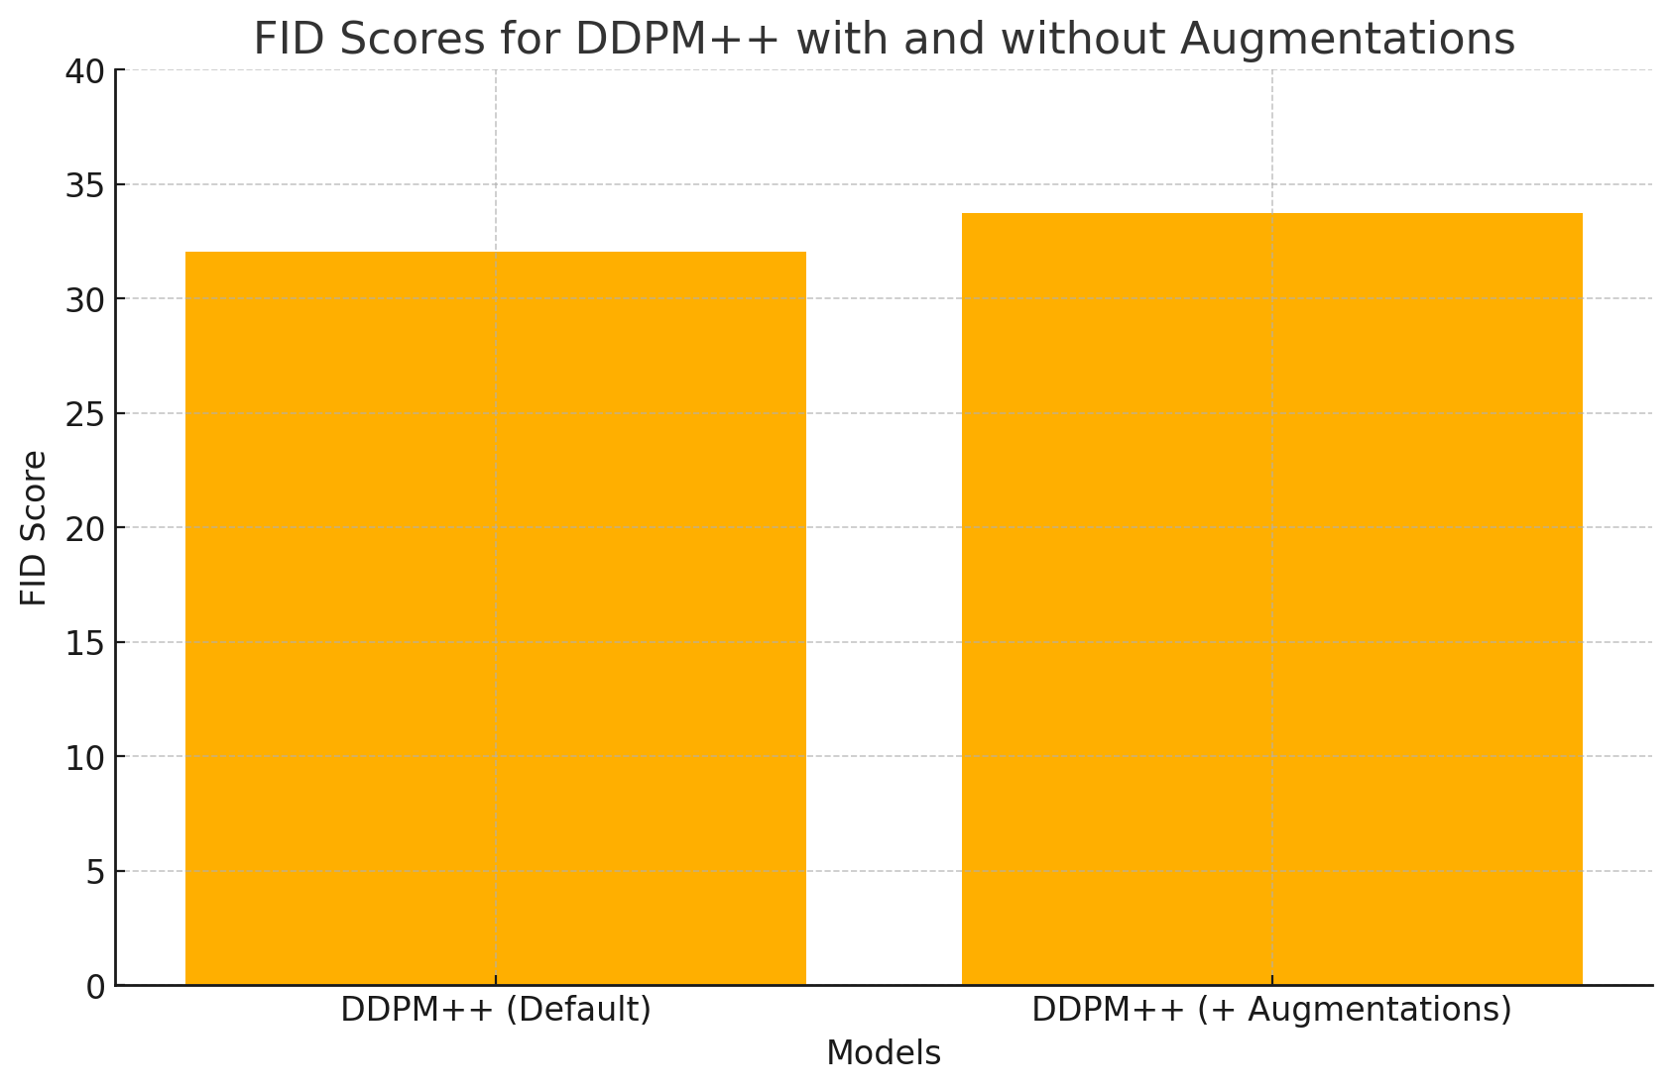
Data Augmentation
Applied the conditions uniformly
Epochs: 50
32.03
33.71
Defualt
X flip
Y flip
Rotate
Translate
Scale
Added
Contrast
Brightness
Hue
Saturation
Luma

Slide 33
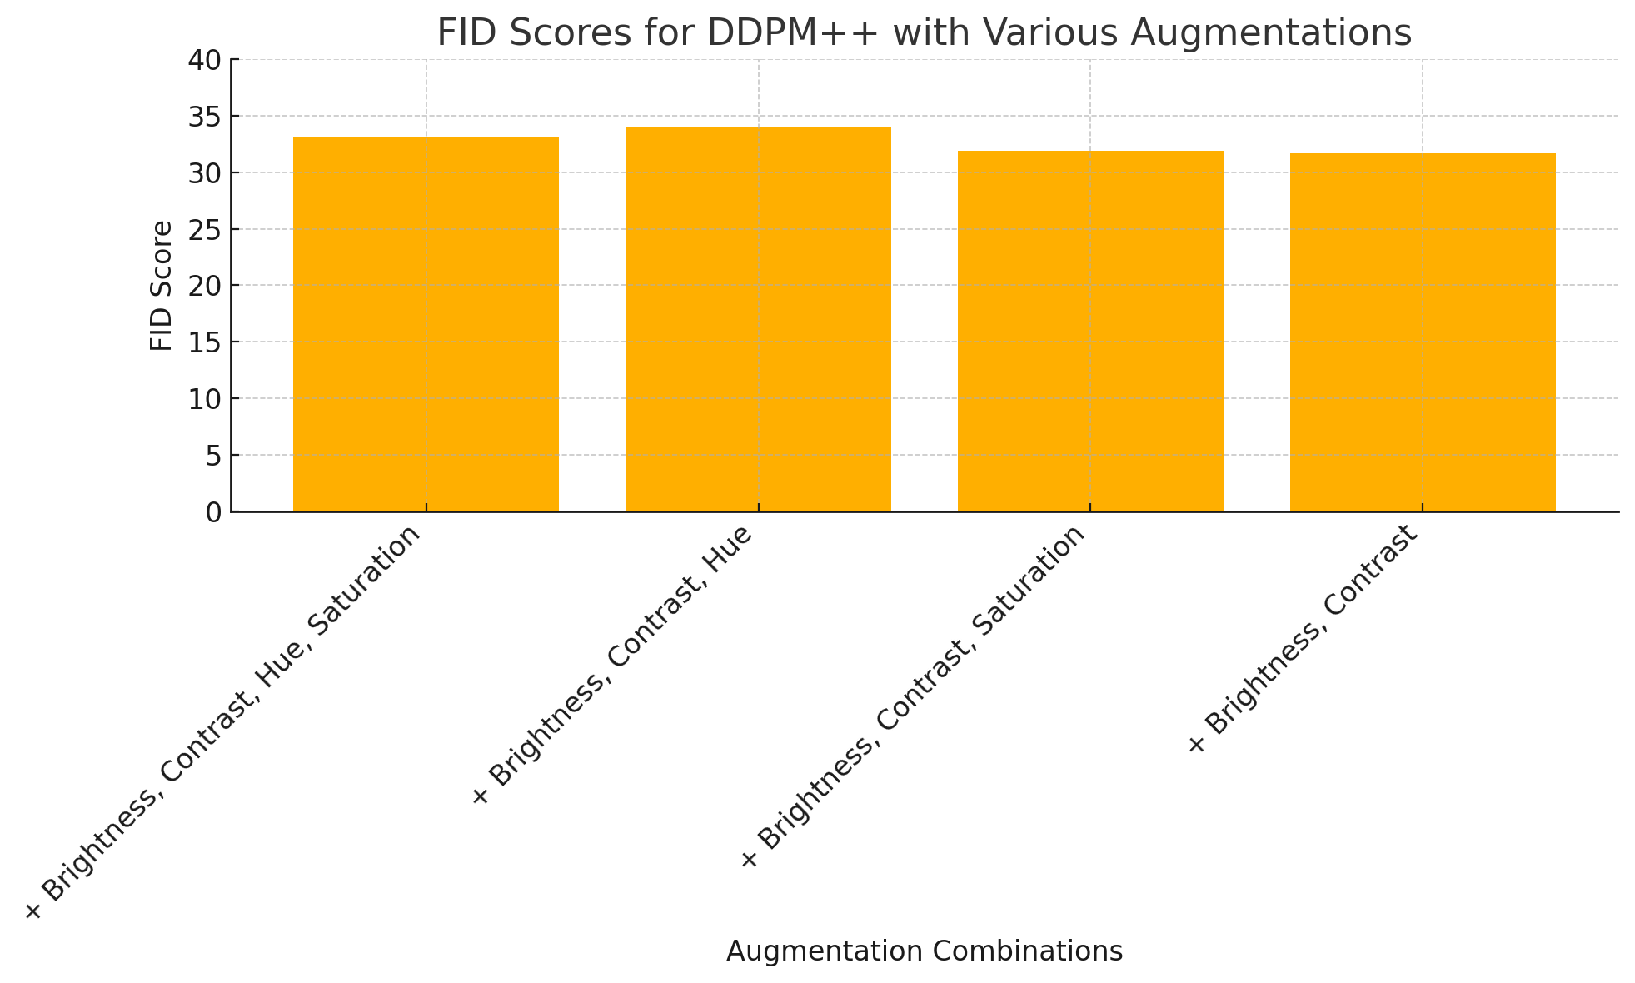
Data Augmentation
Applied the conditions uniformly
Epochs: 50
33.15
34.02
31.91
31.69
Default + Brightness
+ Contrast
32.03 -> 31.69

Slide 34
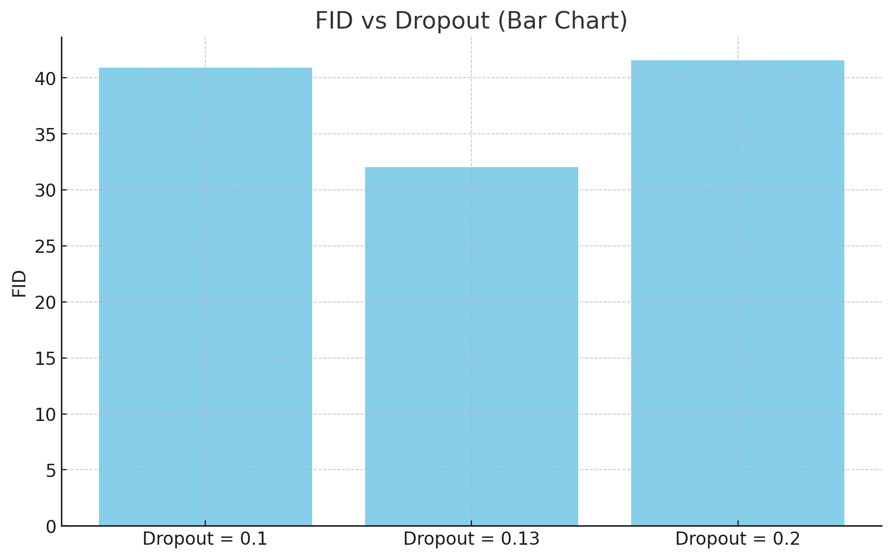
DropOut
Applied the conditions uniformly
Epochs: 50
Adjustment:
Dropout rate was changed to conduct a performance improvement experiment.
Objective:
At Dropout rate 0.13, the FID records the lowest value of 32.03, demonstrating the best performance.
40.89
32.03
41.56

Slide 35
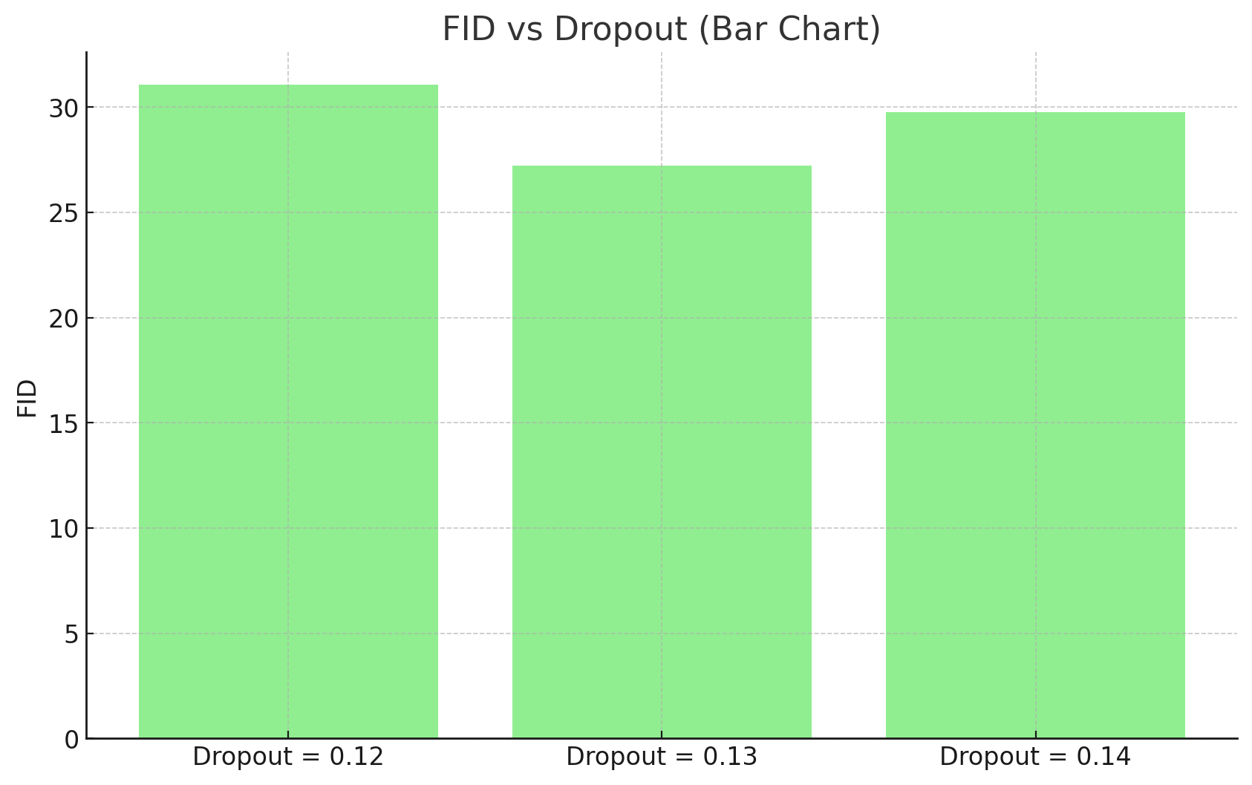
DropOut
(After Learning Rate adjustment)
Applied the conditions uniformly
Epochs: 50
Adjustment:
The dropout rate was adjusted in steps of 0.01 to conduct a performance improvement experiment.
Objective:
At Dropout rate 0.13, the FID records the lowest value of 27.22, demonstrating the best performance.
31.06
27.22
29.78

Slide 36
Ramp up
The code calculates the ramp-up ratio for adjusting the learning rate.
cur_nimg : The total number of images processed so far.
lr_rampup_kimg * 1000 : Specifies the ramp-up period (learning rate increase) in terms of the total number of images to be processed.

Slide 37
Ramp up
1. Background
• Total training images: Reduced from 200,000 kimg to 27,500 kimg
• Total training time: Fixed and limited
2. Issue
• Previous setting (lr_rampup_kimg = 10,000):
• Learning rate increased too slowly
• Risk of inefficient learning
3. Solution
• New setting (lr_rampup_kimg = 1350):
• Faster ramp-up → Initial learning rate reached earlier
• Ensures efficient learning within the given time
• Higher learning rate for better training in later phases

Slide 38
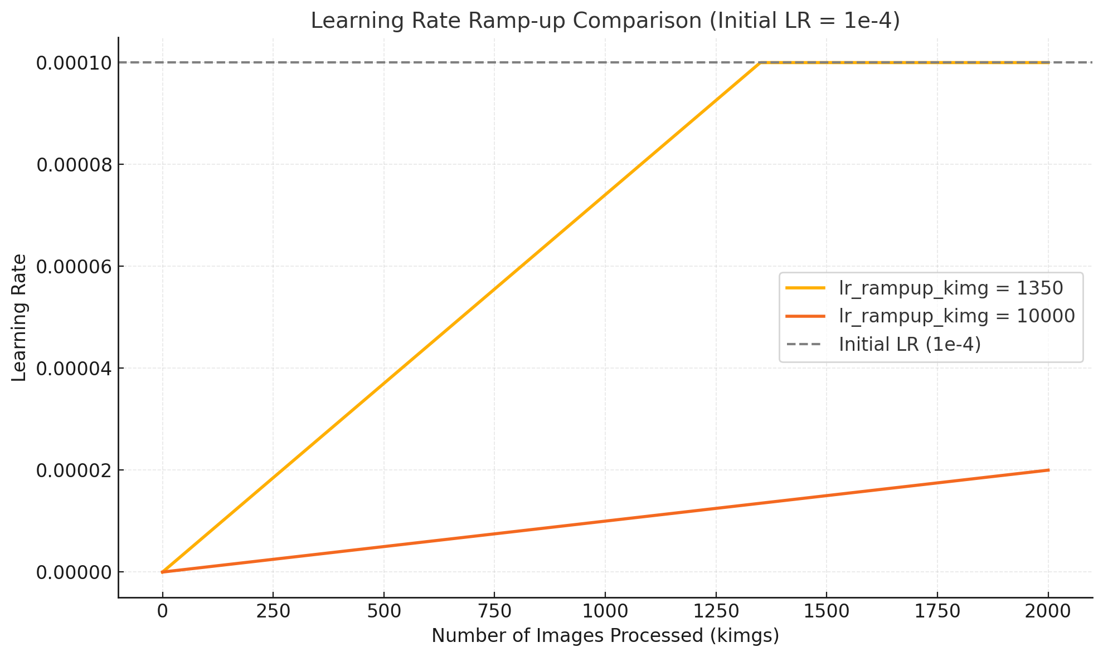
Ramp up
lr_rampup_kimg = 1350: The learning rate increases more quickly, reaching the initial learning rate (1e-4) after processing approximately 1.35 million images.
lr_rampup_kimg = 10000: The learning rate increases more slowly, reaching the initial learning rate (1e-4) after processing approximately 10 million images.

Slide 39
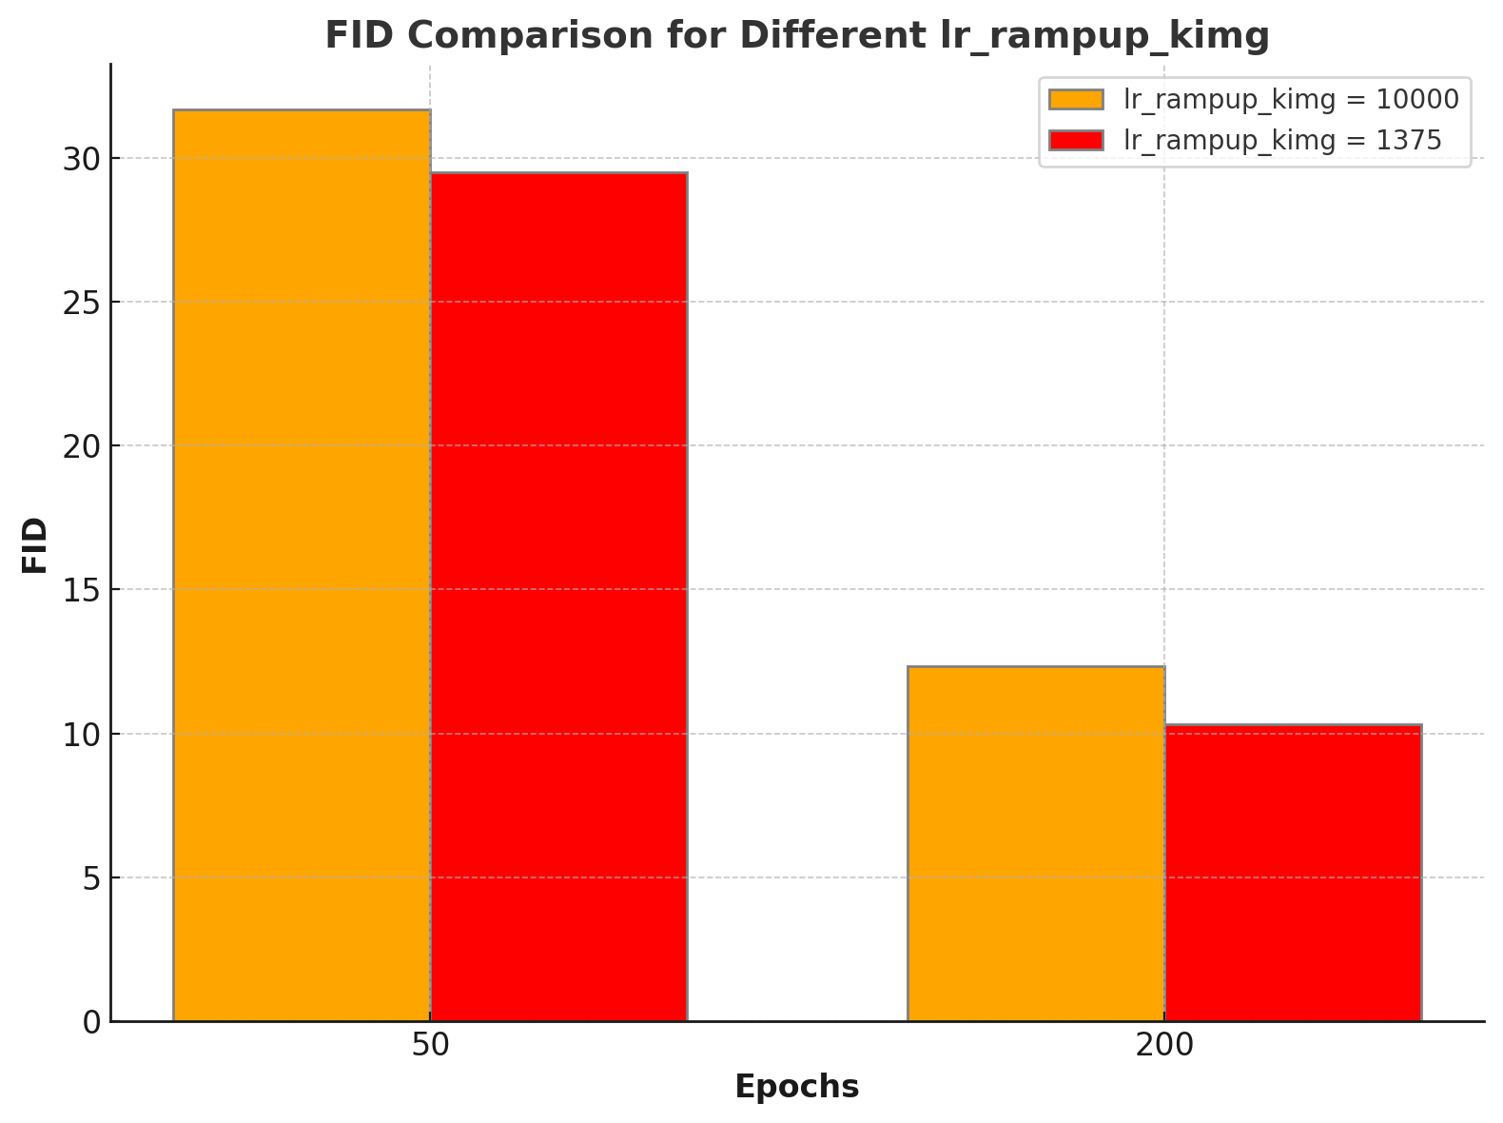
Ramp up
At 50 epochs: FID decreased from 31.69 (lr_rampup_kimg = 10000) to 29.48 (lr_rampup_kimg = 1375).
At 200 epochs: FID further improved from 12.34 to 10.33.
Conclusion
A shorter ramp-up period allows the model to utilize higher learning rates earlier, enabling efficient training and achieving lower FID.

Slide 40
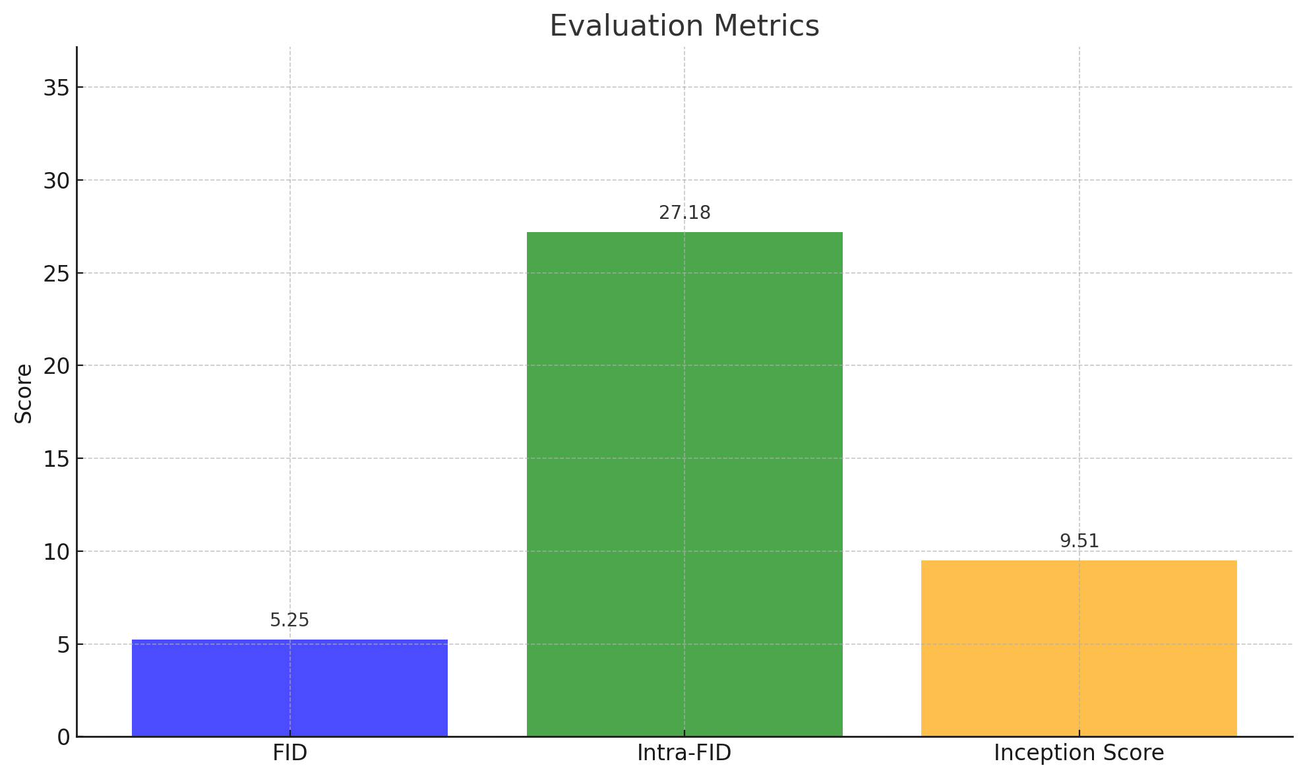
Final Results
DDPM++(model)
epoch: 550
Training Time: 2 days, 21 hours, 8minutes

